Slide 1
Software Defined Radio and GNU Radio
IoT LoRa Based Project

Slide 2
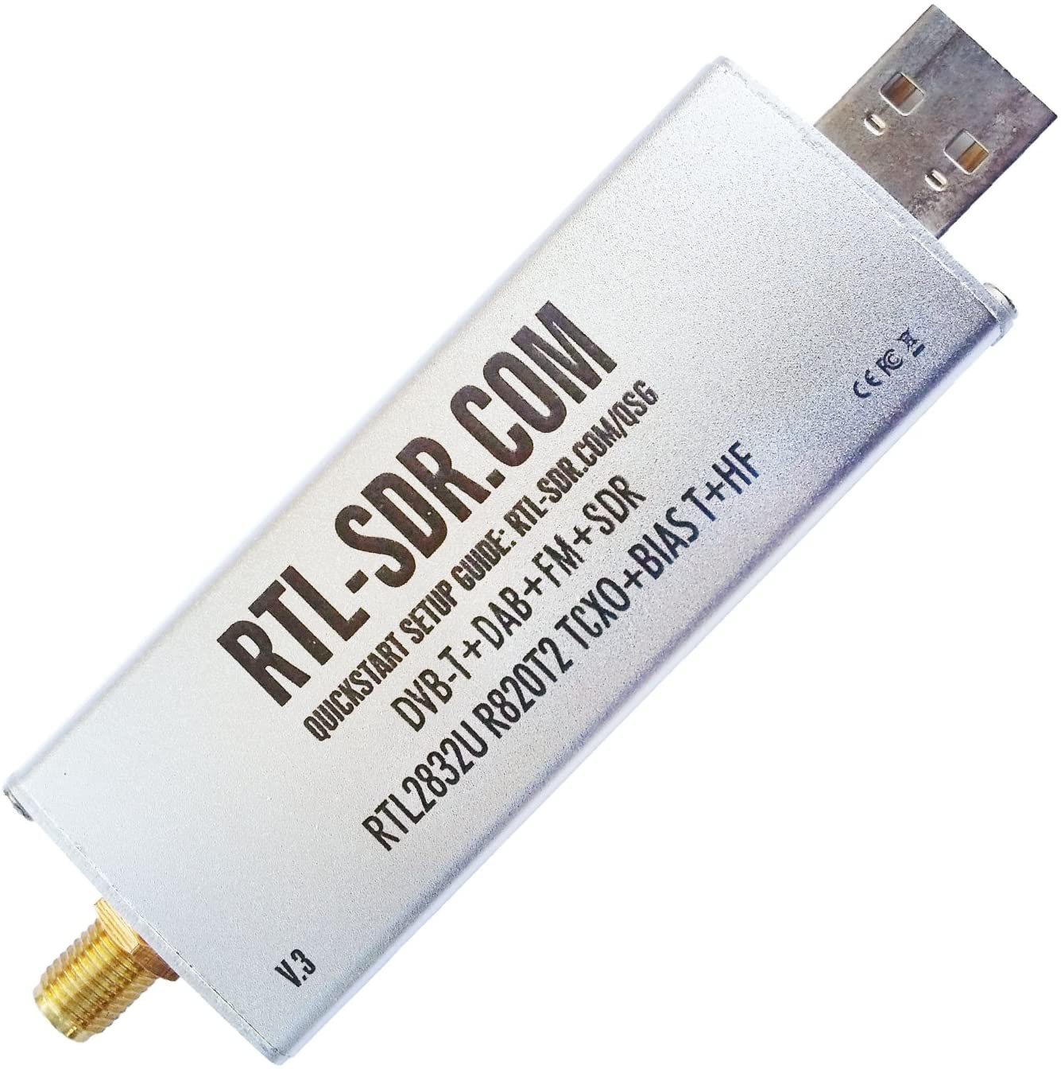
What's an SDR?
Software Defined Radio (SDR): A communication system which implements RF hardware components in software on computers or other types of embedded systems.
One of the advantages of implementing hardware components/blocks in software is flexibility.
Typically a RF front end is either made or purchased and software packages are install on the computer to which the RF front end is attached to.
The front end captures the radio signals, amplifies the captures signals, and filters it.
Finally the front end performs and ADC conversion on the captured signals.
Once the signals have been digitized, the bits are sent to the computer or embedded system.

Slide 3
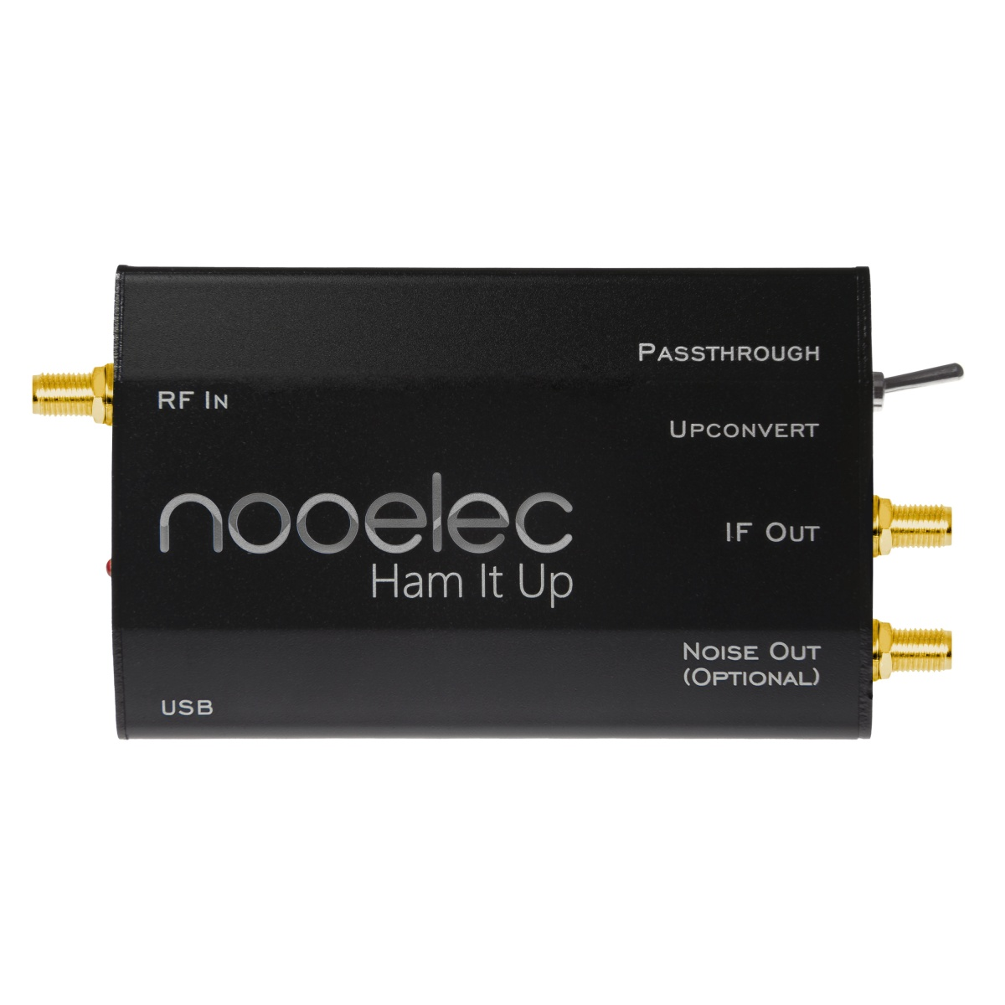
Comparing Different SDRs
Nooelec NESDR Series
~$150 USD
Pros:
Affordability: These devices are budget-friendly, making them accessible to hobbyists and beginners.
Wide Frequency Range: Covers a broad spectrum, typically from 25 MHz to 1.75 GHz.
Versatility: Compatible with various SDR software like SDR#, GQRX, and HDSDR, suitable for multiple applications.
Portability: Compact size makes them easy to carry and integrate into different setups.
Community and Support: Active community and good support from Nooelec.
Cons:
Performance Limitations: Not as high-performance as more expensive SDRs, which might be a limitation for advanced users.
Sensitivity: Can be more susceptible to noise and interference compared to higher-end models.
Build Quality: While generally good, it may not be as robust as more premium devices.
Receive only.

Slide 4
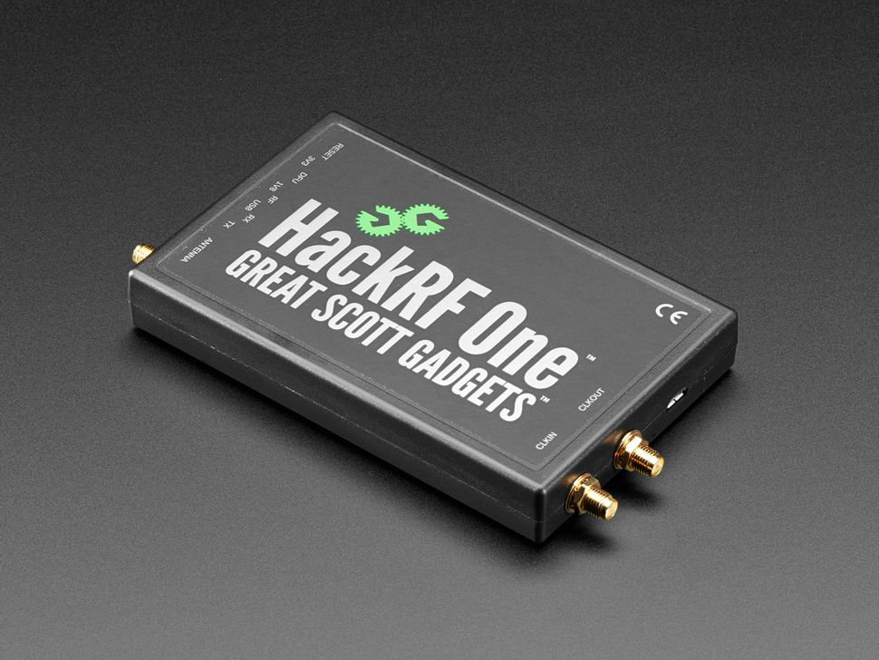
Comparing Different SDRs
HackRF One
~$350 USD
Pros:
Wide Frequency Range: Covers 1 MHz to 6 GHz
Open Source: Fully open-source hardware and software
High Sampling Rate: Up to 20 million samples per second
Community Support: Large community and extensive online resources
Transmit and Receive
Cons:
Half-Duplex: Cannot transmit and receive simultaneously
Low Max Input Power: Maximum input signal power is -5 dBm, which can be easily damaged by stronger signals
Power Amplifier Sensitivity: The power amplifier in the transmitter is susceptible to damage
Expensive

Slide 5
Comparing Different SDRs - The Winner is RTL-SDR
RTL-SDR is a low-cost software-defined radio (SDR) that uses a USB dongle originally designed for DVB-T TV reception.
It can receive frequencies from approximately 500 kHz to 1.75 GHz, making it versatile for various applications.
The RTL-SDR dongle is based on the RTL2832U chipset, which allows direct access to raw I/Q data.
This capability transforms the dongle into a wideband SDR through custom software drivers.
RTL-SDR is popular among hobbyists due to its affordability, typically costing around $30 USD.
It supports a wide range of applications, including police and fire radio scanning, aircraft tracking, and weather balloon data reception.
The community has developed numerous free software tools to enhance the functionality of RTL-SDR.
Despite its low cost, RTL-SDR provides access to the radio spectrum that was previously only available with expensive equipment.

Slide 6
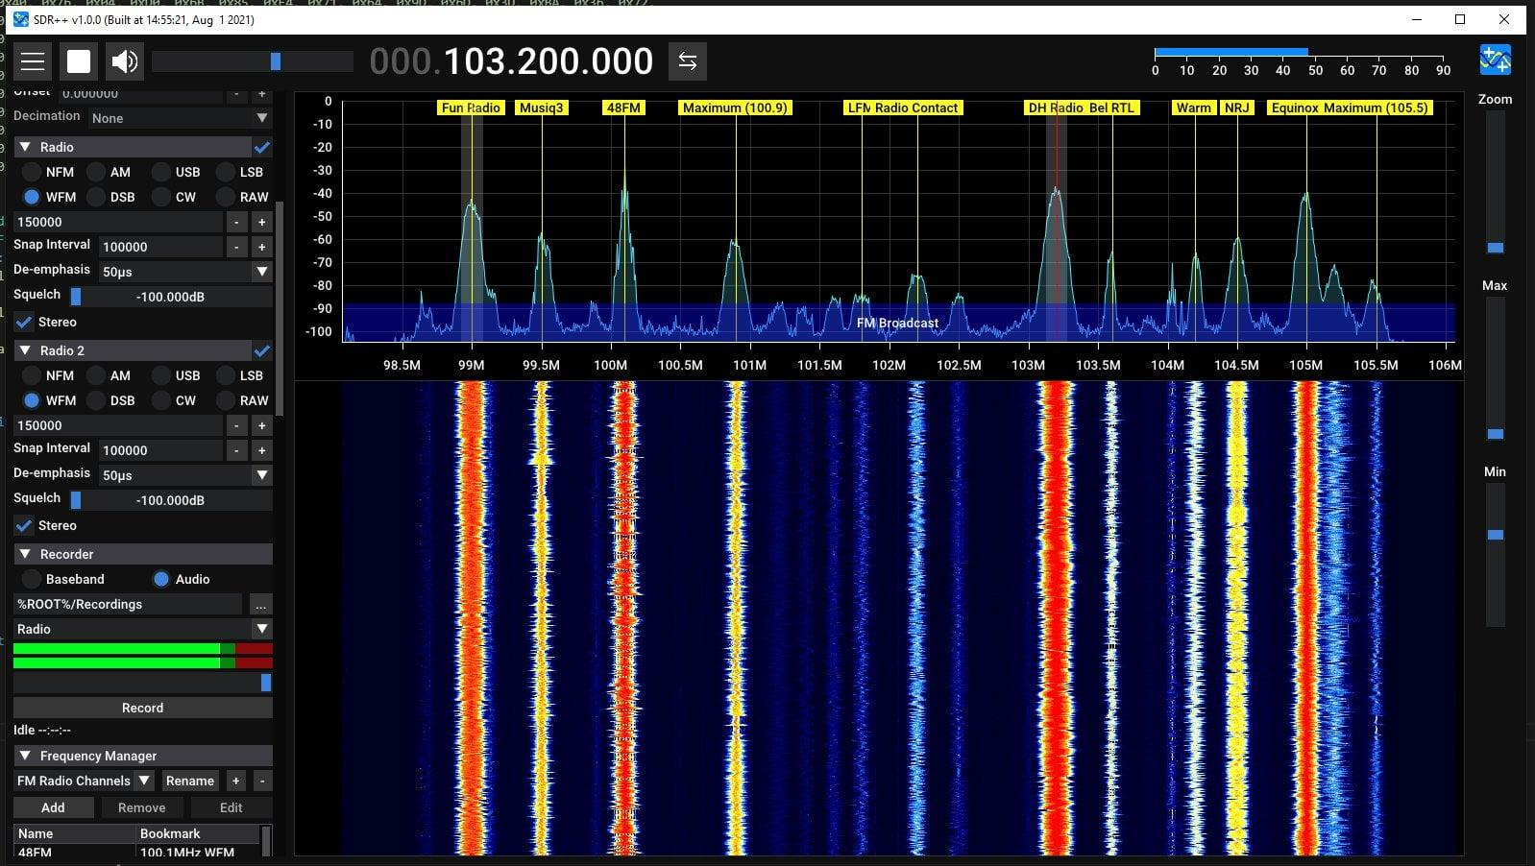
RTL-SDR Software (SDR Sharp)

Slide 7
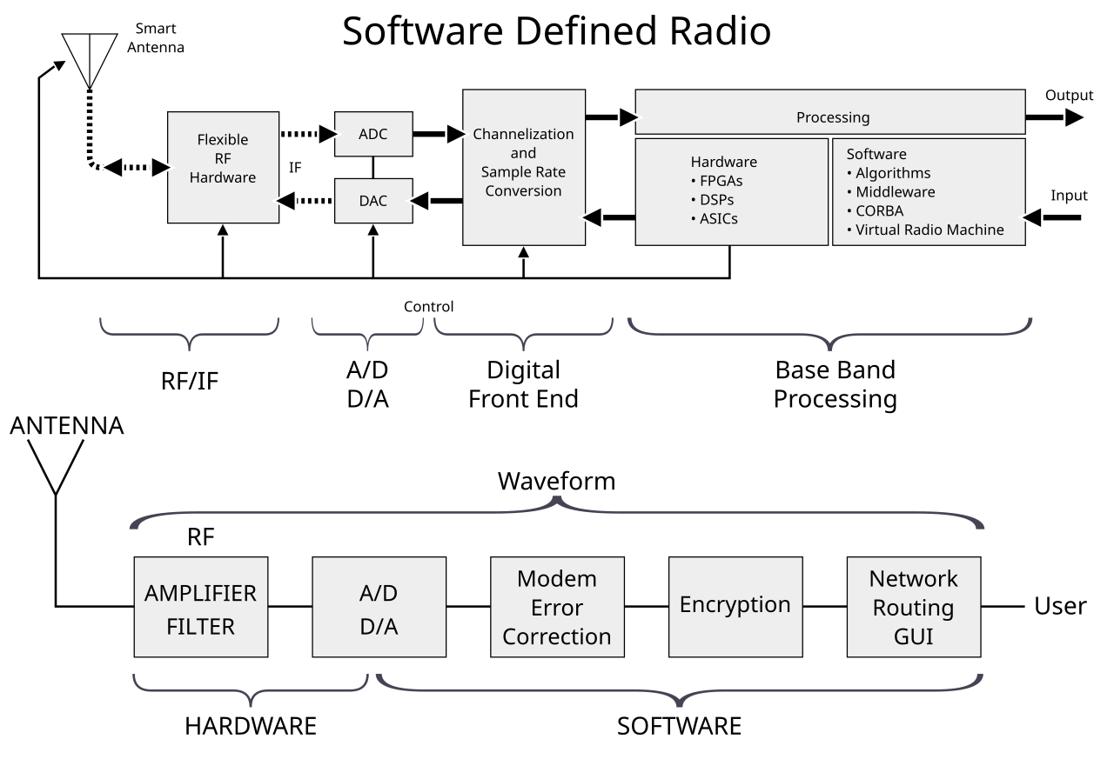
Block Diagram of an SDR System
https://en.wikipedia.org/wiki/File:SDR_et_WF.svg

Slide 8

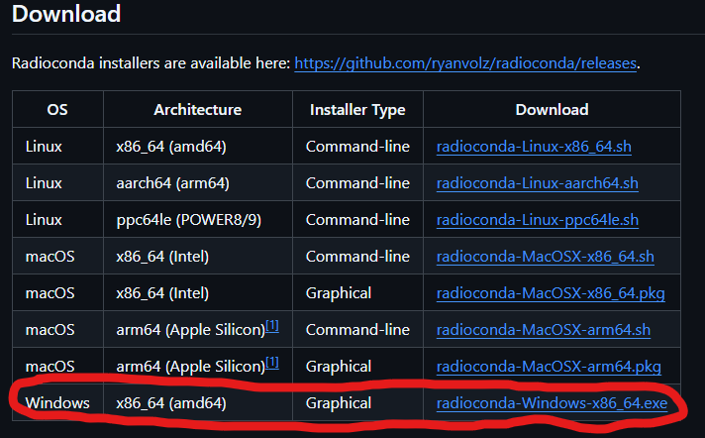
What is GNU Radio?
GNU Radio is a free and open-source software kit for signal processing blocks for software radios.
GNU Radio can be used with both external RF equipment or stand-alone in simulation
Software is available here (Windows only but also works on Linux): (Link)
In this tutorial we will be using the windows OS.
Choose the graphical installer type (see figure)

Slide 9
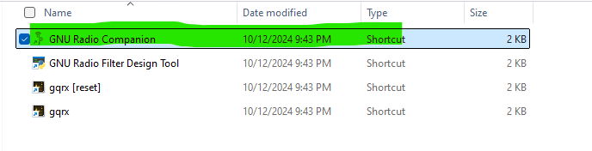
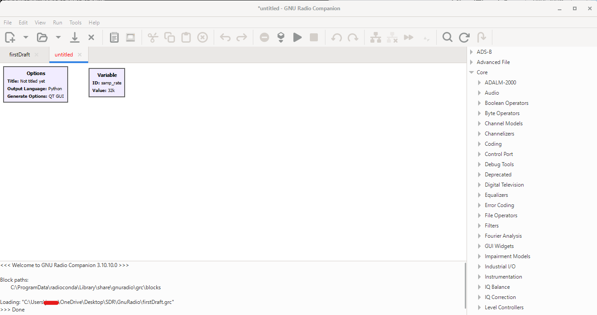
Using GNU Radio
After installing GNU radio, you should have the “GNU Radio Companion”
Open the folder containing the GNU Radio Companion application
This is the GUI that you should have after opening the application

Slide 10
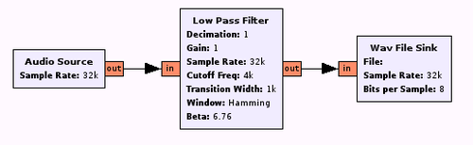
GNU Radio Core Concepts TutorialsCoreConcepts - GNU Radio
Flow Graphs:
Flow Graphs: At the core of GNU Radio are flow graphs, which are essentially directed graphs where data flows from one block to another.
Each node in the graph represents a signal processing block, and the edges represent the data paths between these blocks

Slide 11
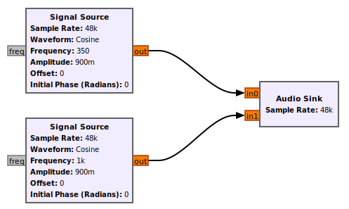
GNU Radio Core Concepts
Blocks:
These are the fundamental building units of a flow graph. Each block performs a specific function, such as filtering, modulation, or demodulation.
Blocks can be sources (producing data), sinks (consuming data), or intermediate processing.

Slide 12
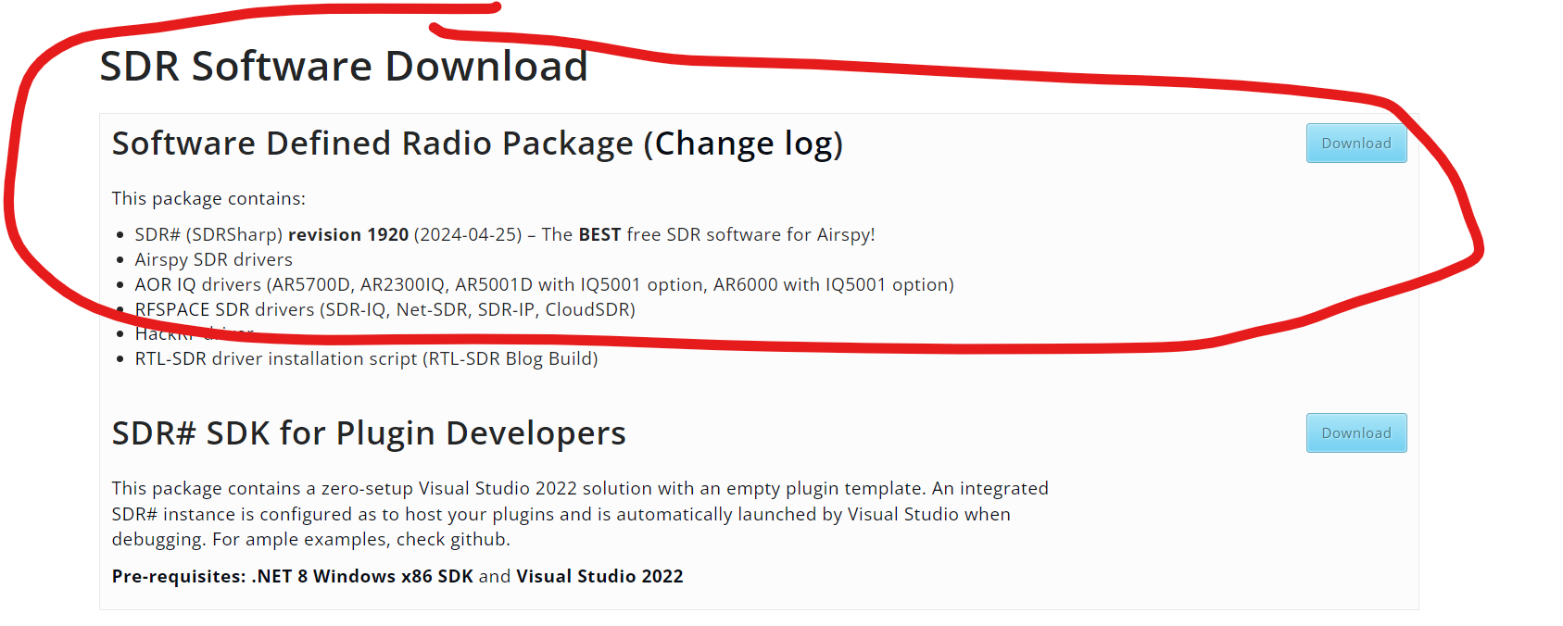
Getting the RTL-SDR Running
Purchase a RTL-SDR ($30-$40)
Install SDR software on computer (List of compatible software: Link)
Go through the set-up page (Link)
The SDR software that will be used is: SDR# (pronounced "SDR Sharp")
Download the software (Link) - Note: Must have .NET 8

Slide 13
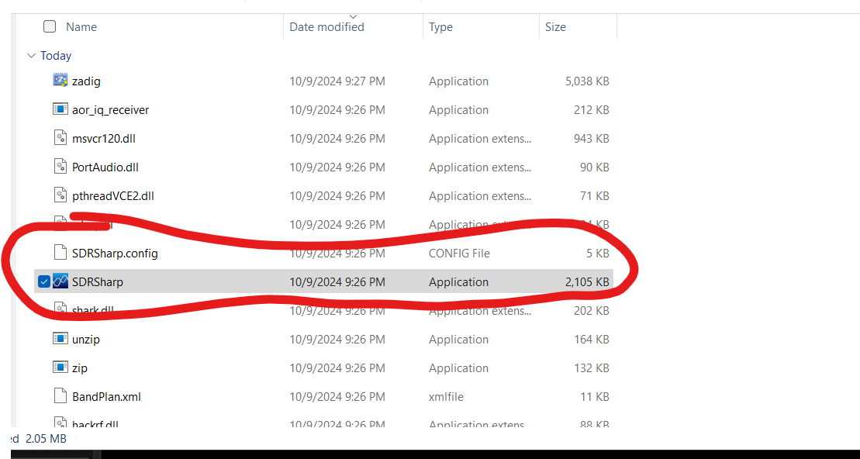
Getting the RTL-SDR Running
After downloading the .zip file. Extract it and run the install-rtlsdr.bat (note you may get a malware warning - run anyways)
After running the installer
SDRSharp application will be installed

Slide 14
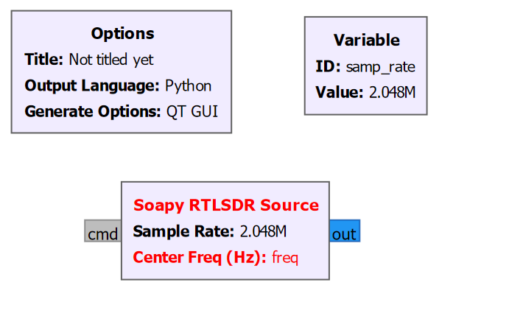
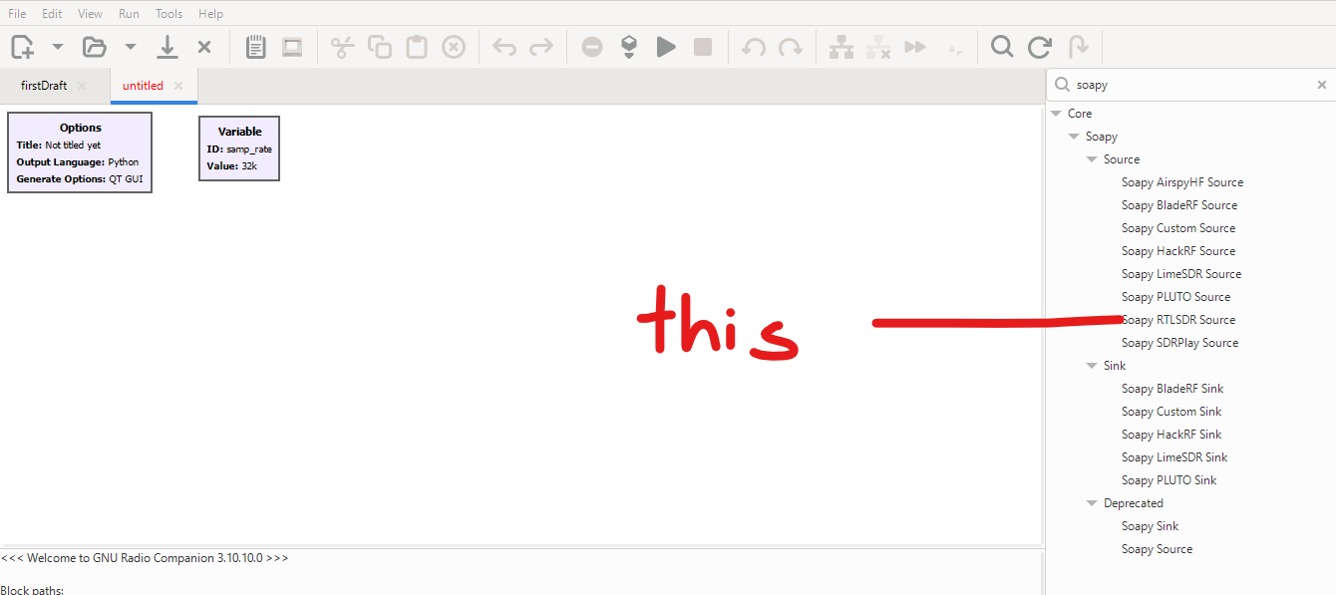
Using the RTL-SDR with GNU Radio
Select the Soapy RTL-SDR Receiver Object and put it in the workspace:
Change the samp_rate variable to 2048000 (remember - this is a global var)

Slide 15
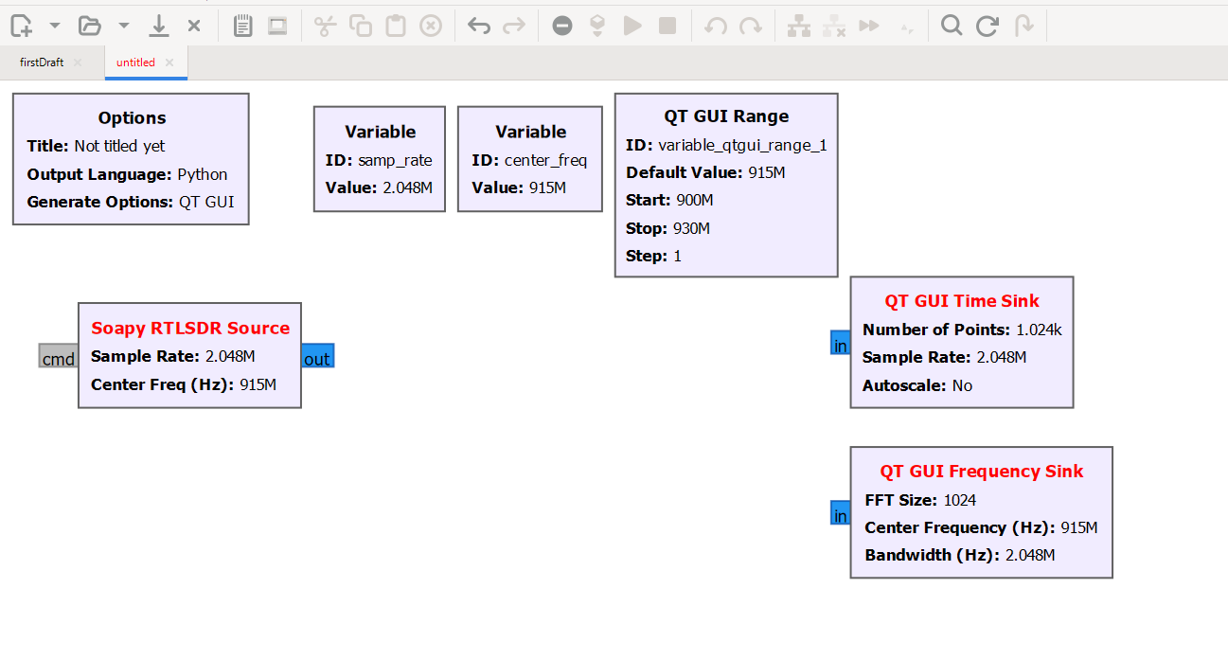
Using the RTL-SDR with GNU Radio
Select the QT GUI Range, QT GUI Time Sink, and QT GUI Frequency Sink Object and put them in the workspace (allow AGC and autoscaling)
Create a new the “center_freq” variable to 915MHz (You can change to any desired center frequency)

Slide 16
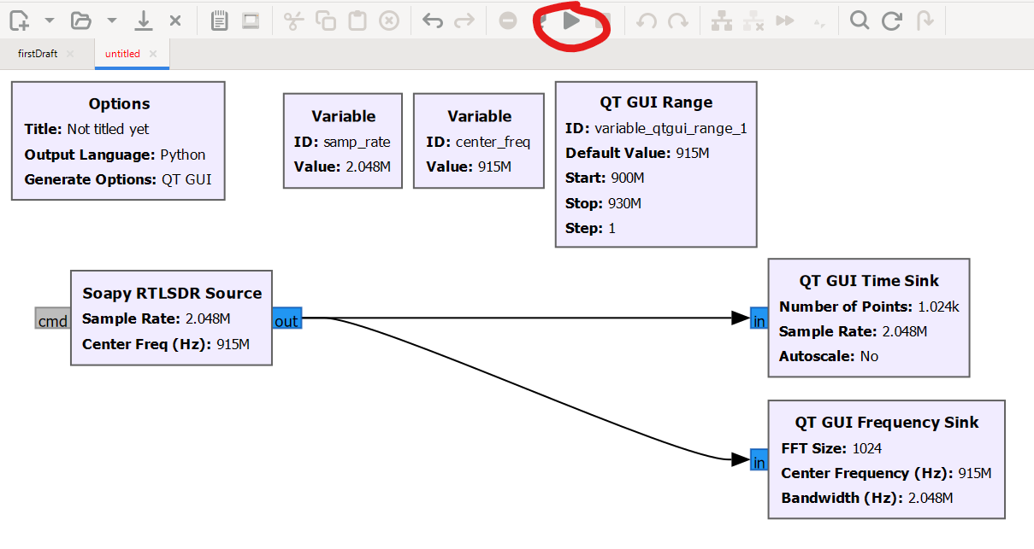
Using the RTL-SDR with GNU Radio
Connect the SDR to the time and frequency GUI sink, then click the play button: What do you see? - MAKE SURE THE SDR IS PLUGGED INTO USB

Slide 17
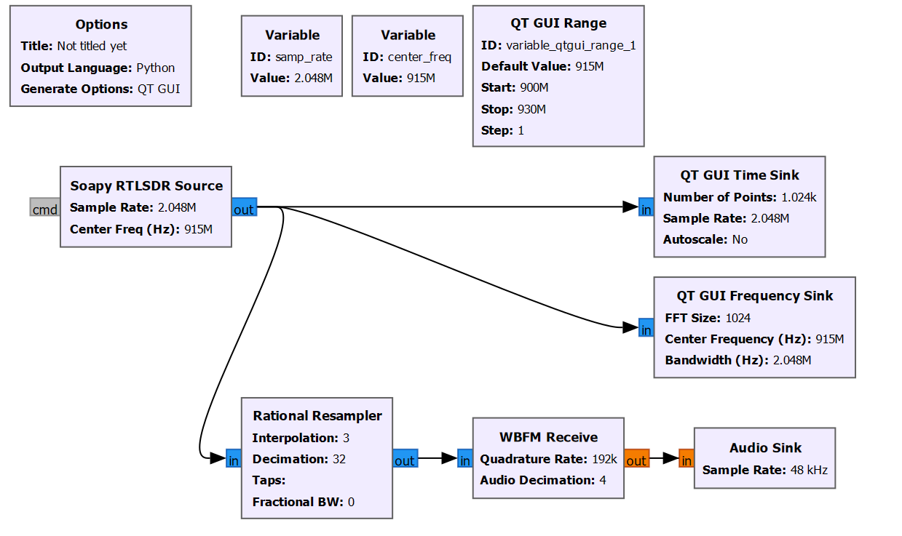
Using the RTL-SDR with GNU Radio
Add the audio sink, WBFM demodulator, and resampler: What do you hear?

Slide 18
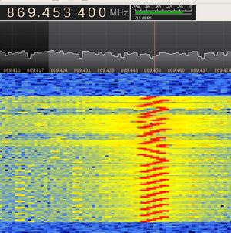
Decoding LoRa
A LoRa packet is divided into 3 portions - preamble, sync, and data.
The preamble is used to initiate communication with the receiver
The bandwidth of the chirp is inversely proportional to the time duration of the chirp - longer chirp time the less bandwidth.
The chirp spread factor is a measure of how long each chirp exists for
Larger Spreading factor - longer range but lower data rates.
Smaller spreading factor - less range but higher data rates.

Slide 19
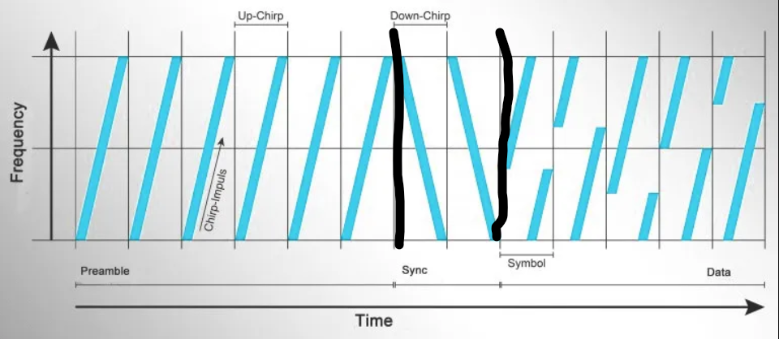
LORA Chirp/Frame

Slide 20
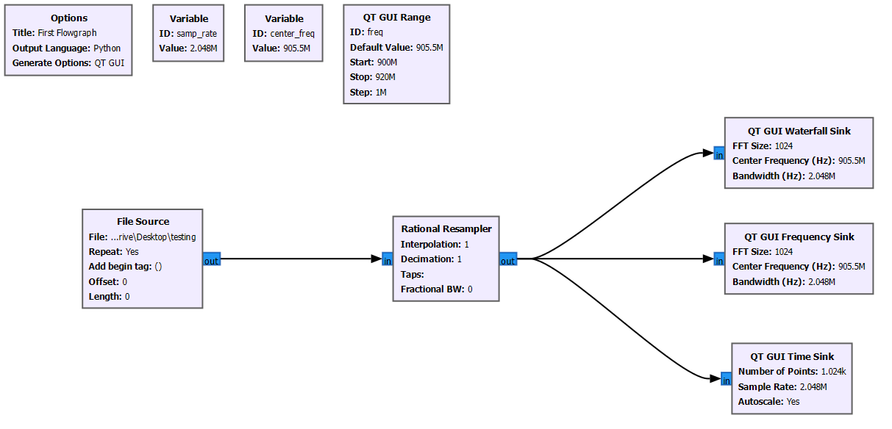
Capturing LoRa Transmissions with RTL-SDR and GNU
Create a new GNU radio environment to include the following (center_freq should be the center frequency of the LoRa transmission.):

Slide 21
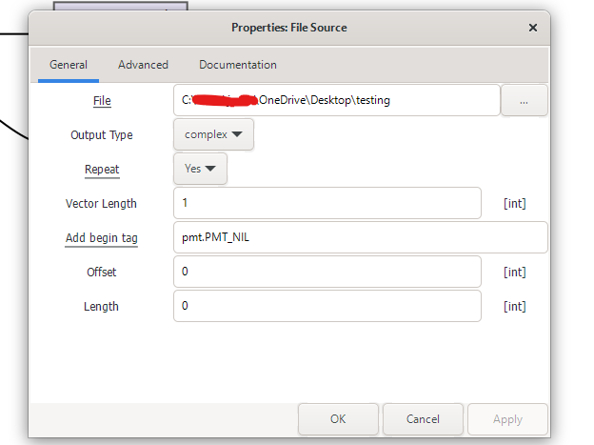
Capturing LoRa Transmissions with RTL-SDR and GNU
After capturing the raw IQ data of the LoRa transmission, edit the File Source to link the collected data
Provide the file path to the File Source block.
And make sure that the repeat tag is set to yes.
Click the start button, you should see the recorded data.

Slide 22
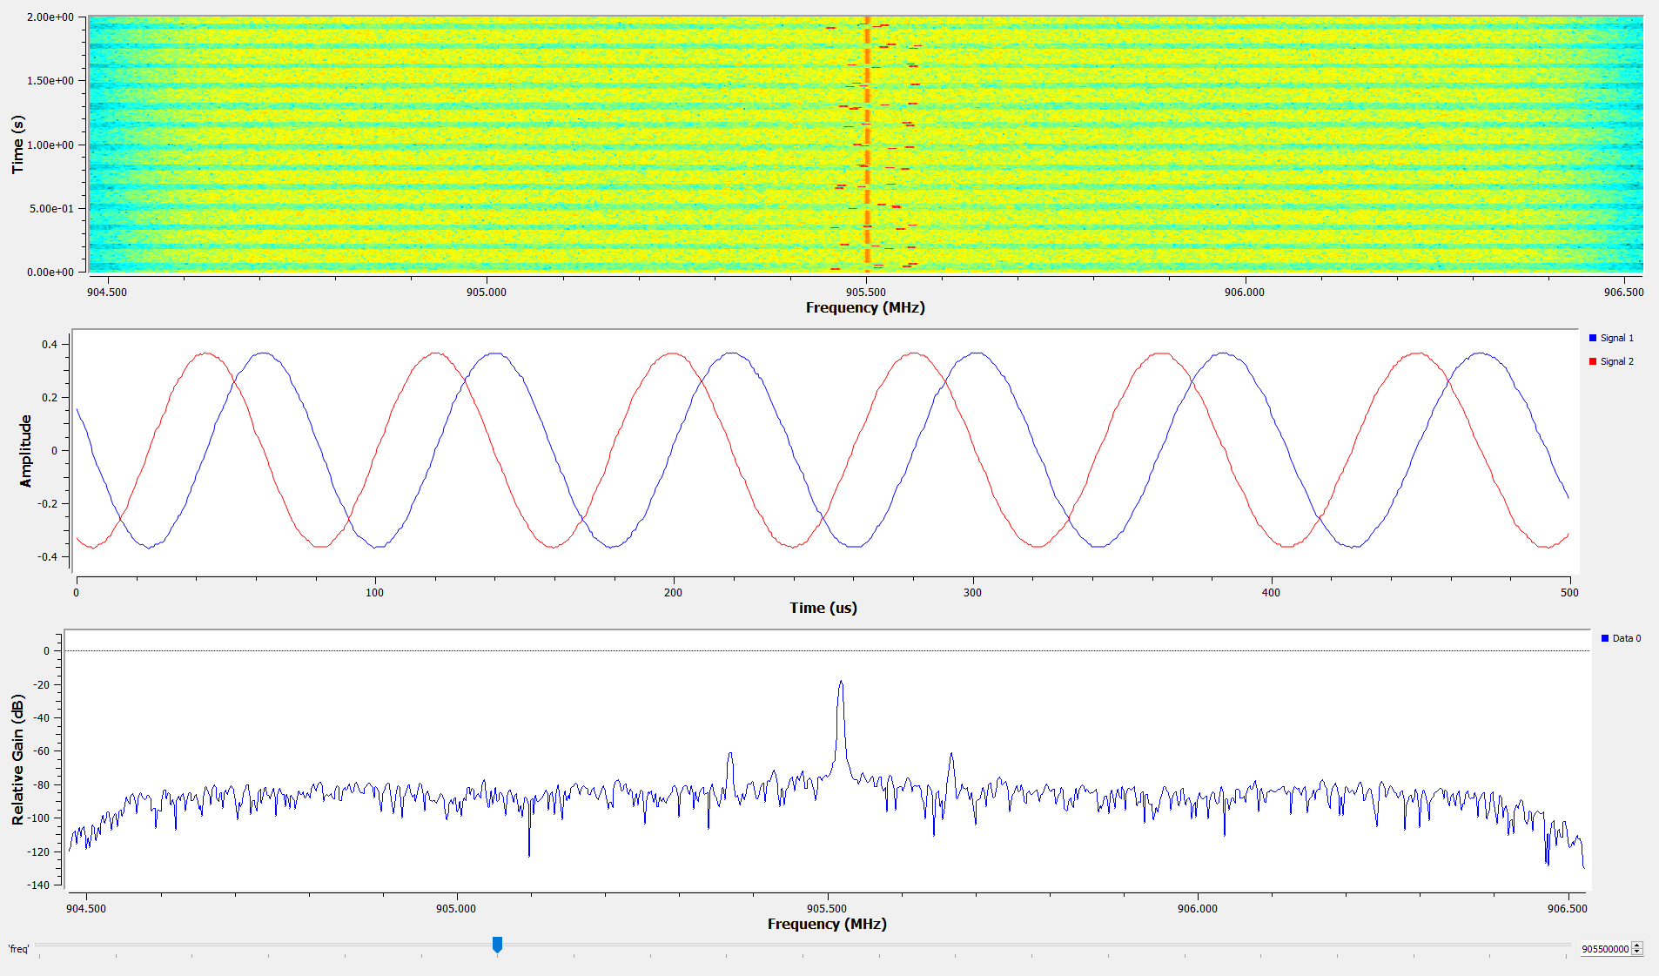
Capturing LoRa Transmissions with RTL-SDR and GNU
Should see something like this (play around with the decimation level):

Slide 23
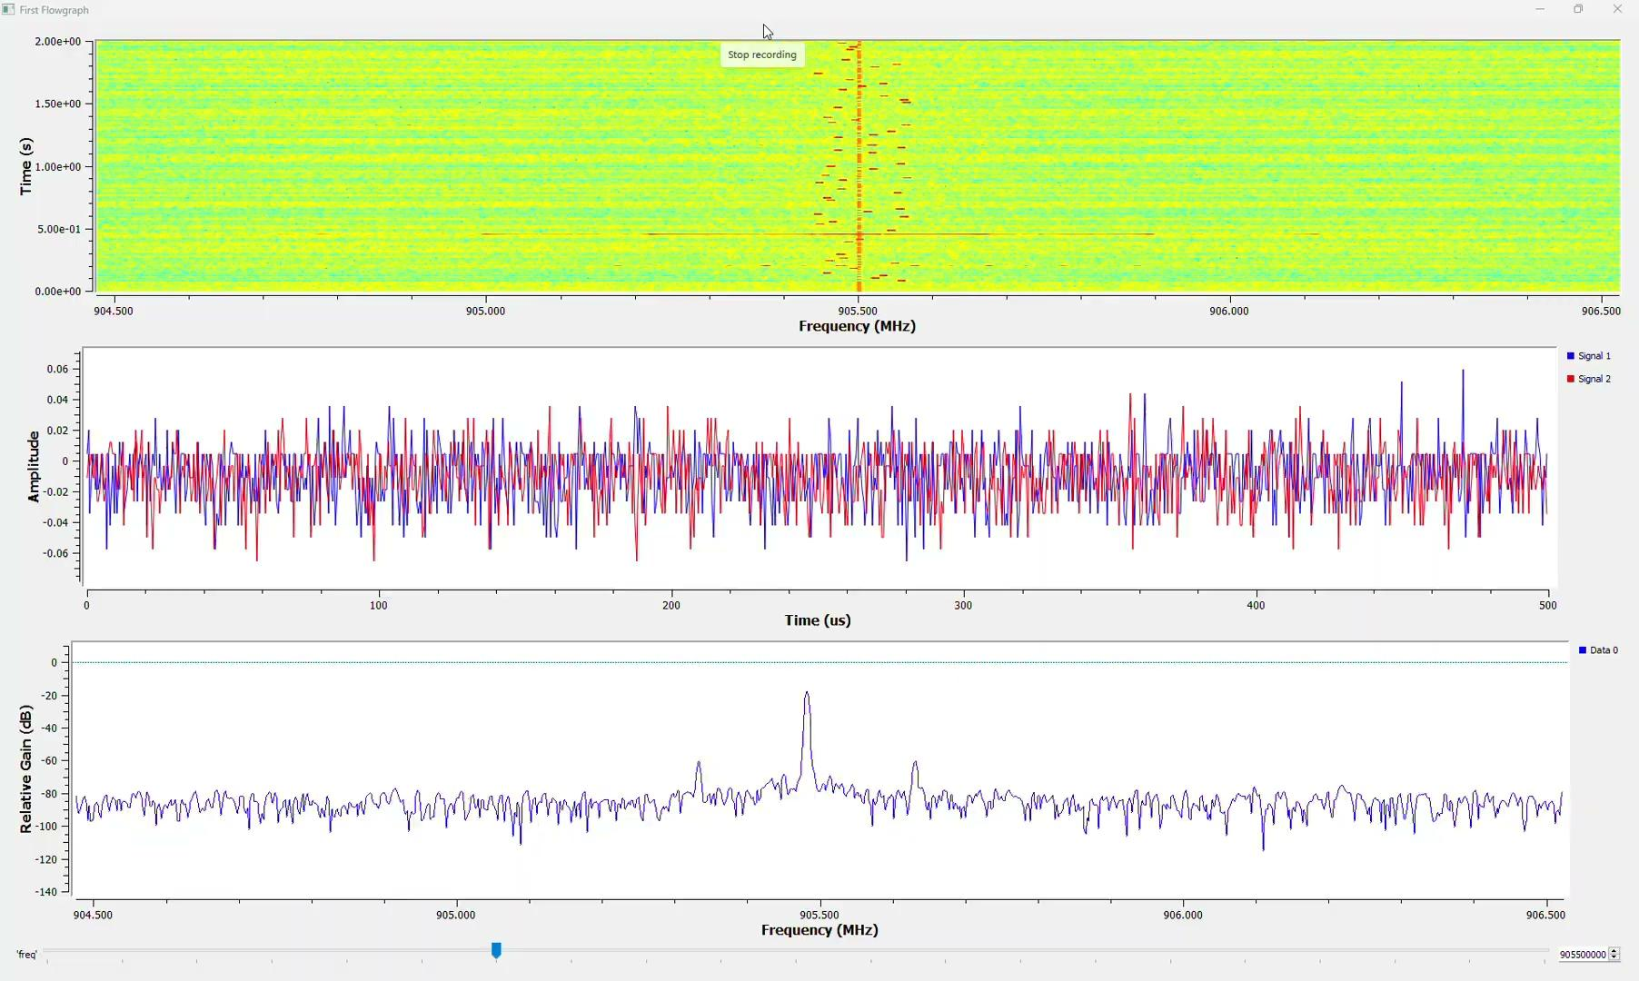
Capturing LoRa Transmissions with RTL-SDR and GNU

Slide 24
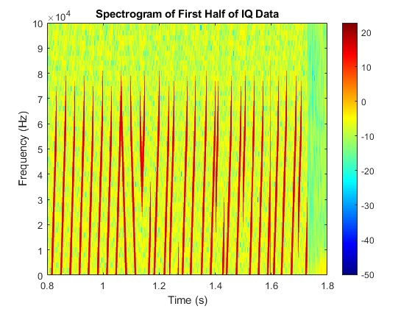

Capturing LoRa Transmissions with RTL-SDR and MatLab
You can also use MATLAB to do DSP on the raw data collected from the SDR
Spectrogram Plot of LoRa Packet:
*How many chirps are used in the preamble?
*How many sync chirps?
At approximately what time does the data start?
Answer: 8 - you can see 8 chirps on the far left

Slide 25
Try to Decode this FM signal at 145MHz
Navigate to: https://github.com/RMCATSSU1/EE570_IoT_LoRa/blob/develop/RakModule/2mAmateurRadioCapture.zip
Unzip the folder and experiment with the decimation value in GNU Radio.

